Slide 1



Slide 2
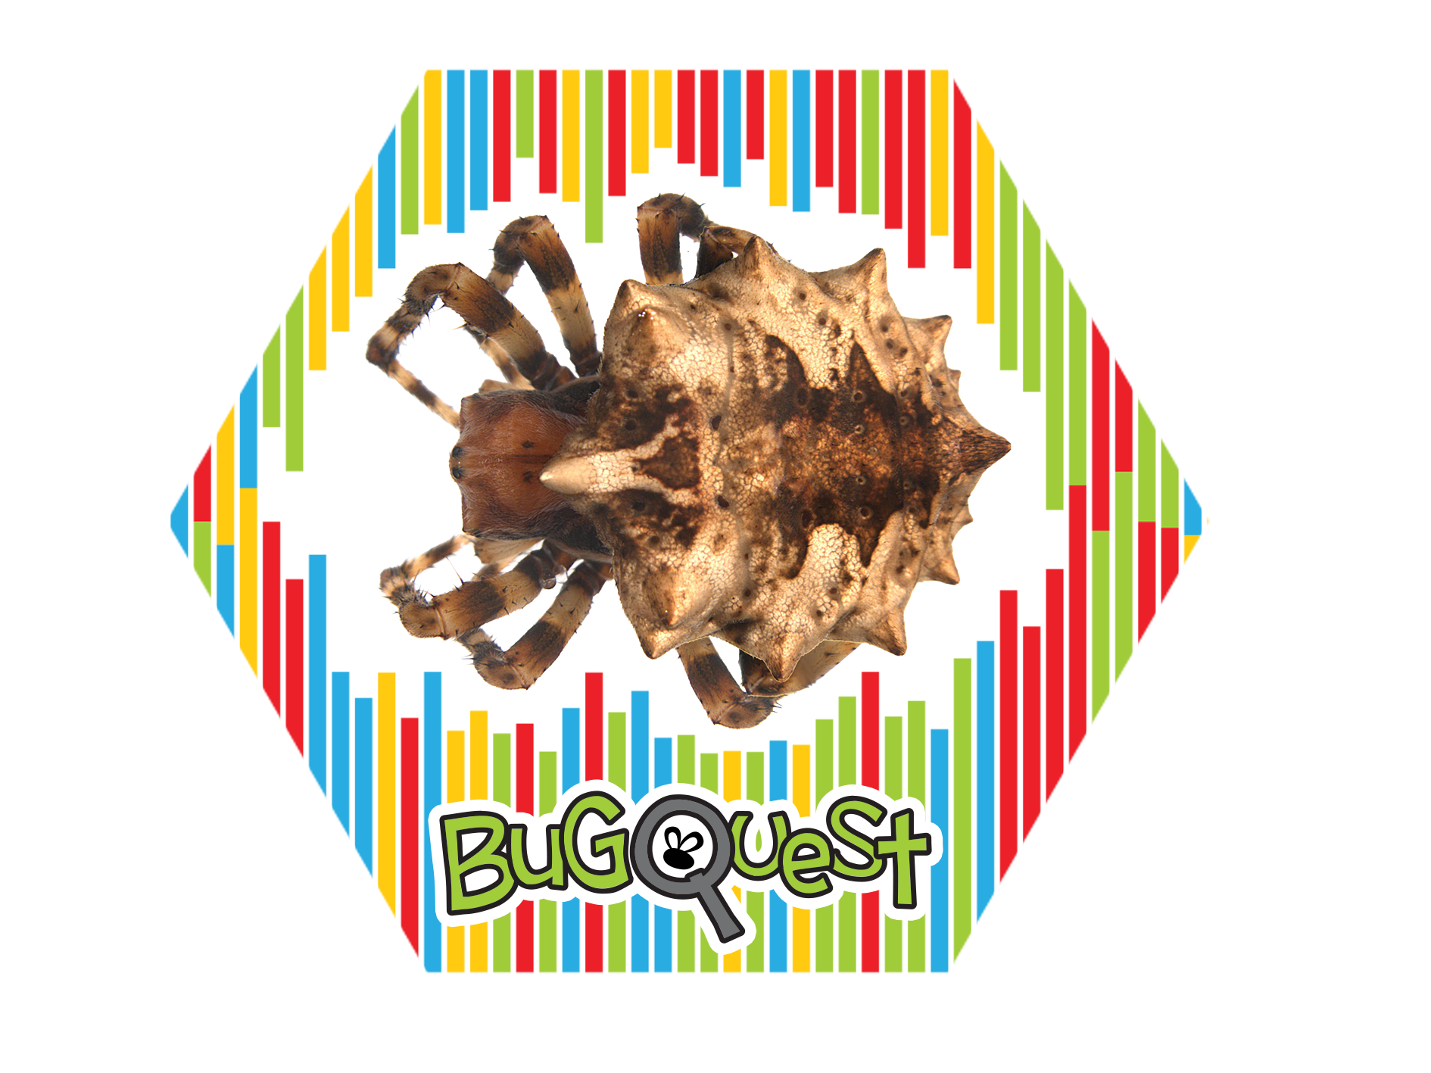

Slide 3
Acanthepeira stellata
Starbellied Spider

Slide 4


Slide 5
Actias Luna
Luna Moth

Slide 6


Slide 7
Agapostemon virescens
Striped Sweat Bee

Slide 8
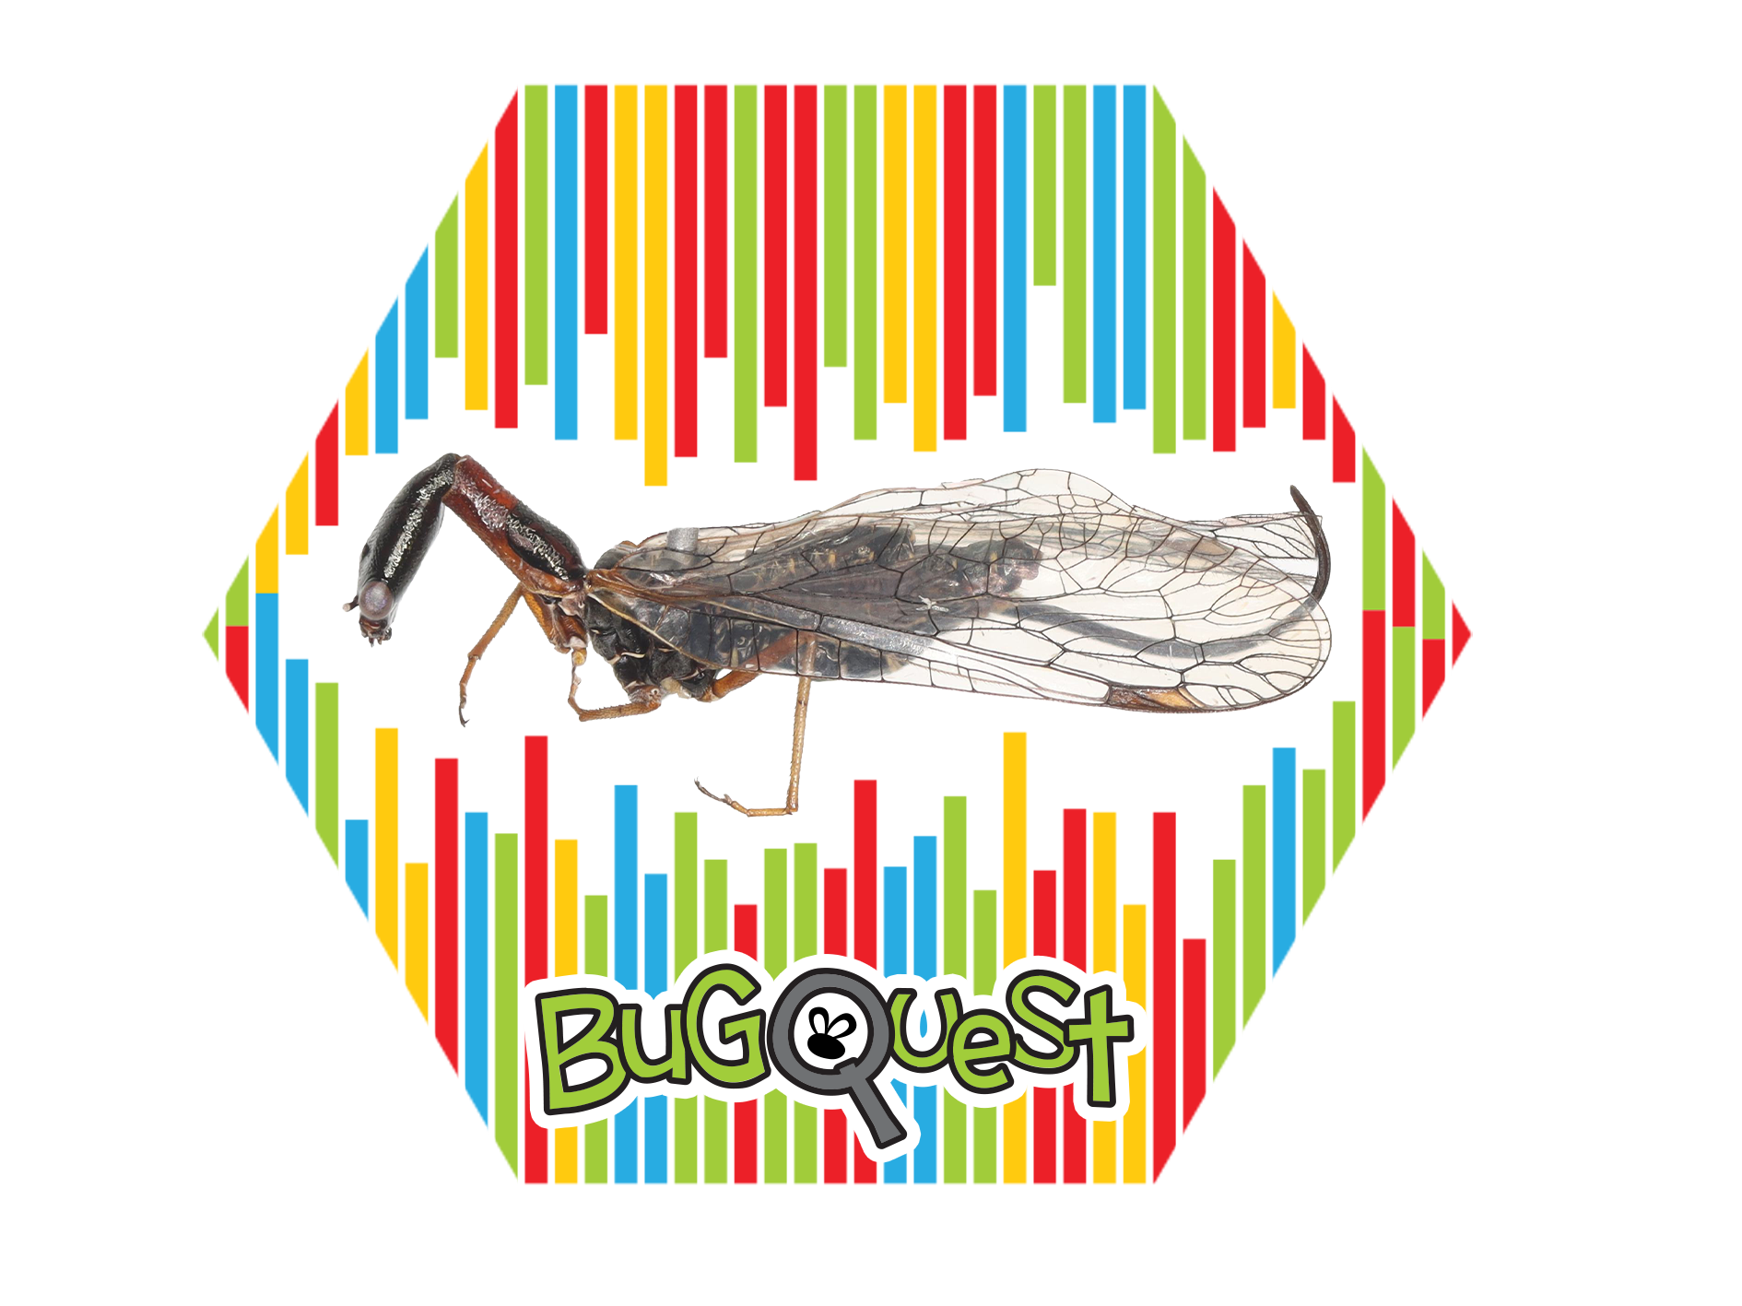

Slide 9
Agulla Bicolor
Snakefly

Slide 10


Slide 11
Augochlora
Green Sweat Bee

Slide 12
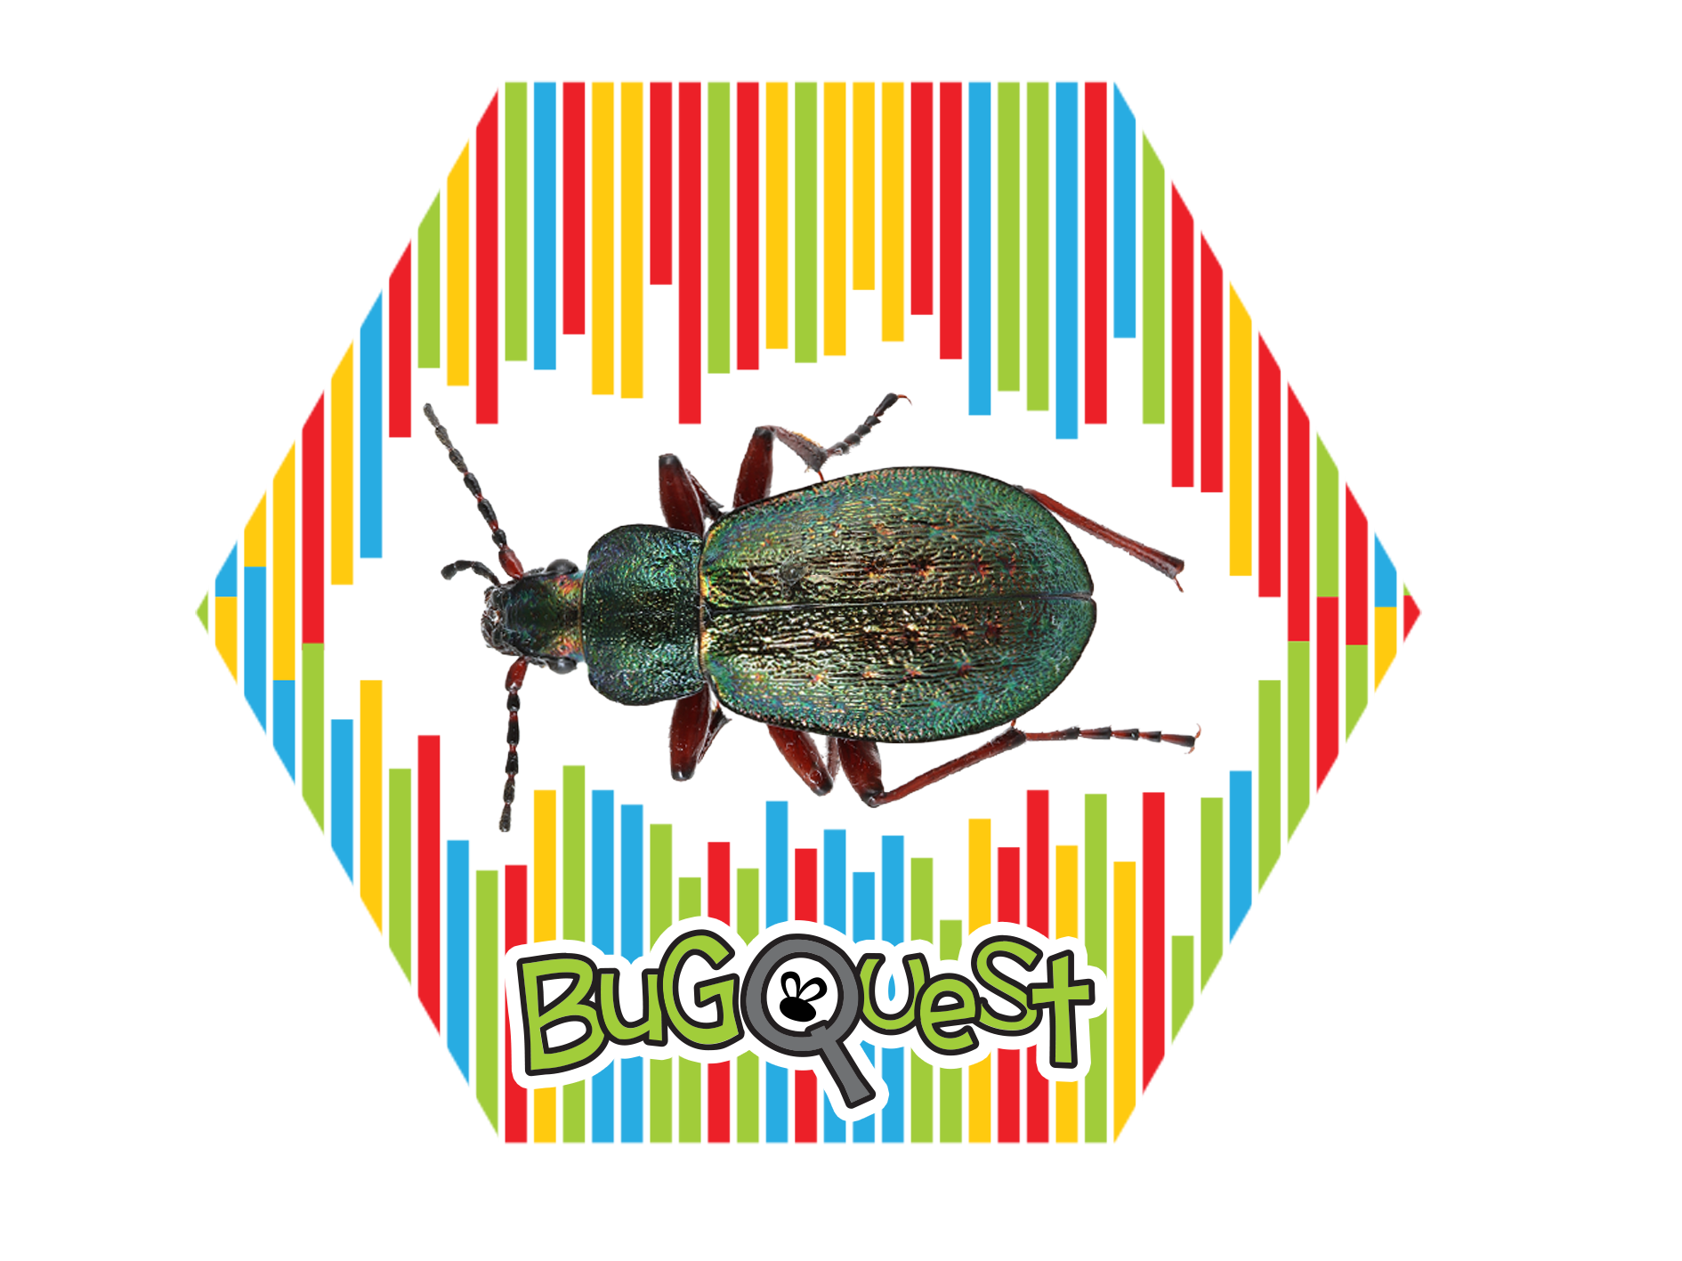

Slide 13
Carabus Truncaticollis
Slug Hunter Beetle

Slide 14


Slide 15
Cicindela sexguttata
Six-spotted green tiger beetle

Slide 16


Slide 17
Corydalus cornutus
Dobsonfly

Slide 18


Slide 19
Diapheromera femorata
Common walkingstick

Slide 20
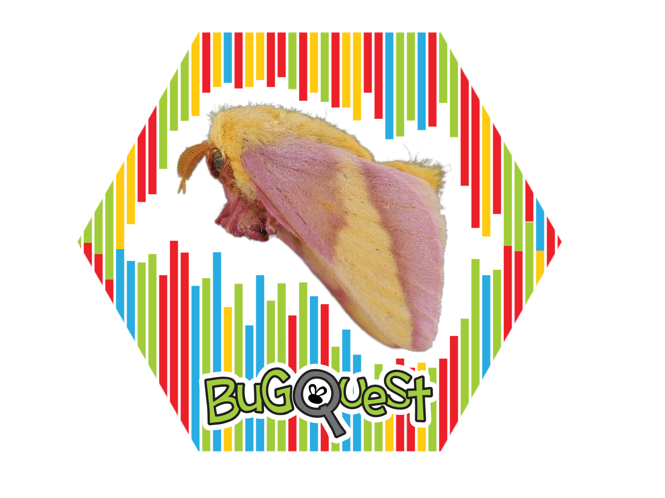

Slide 21
Dryocampa rubicunda
Rosy maple moth

Slide 22
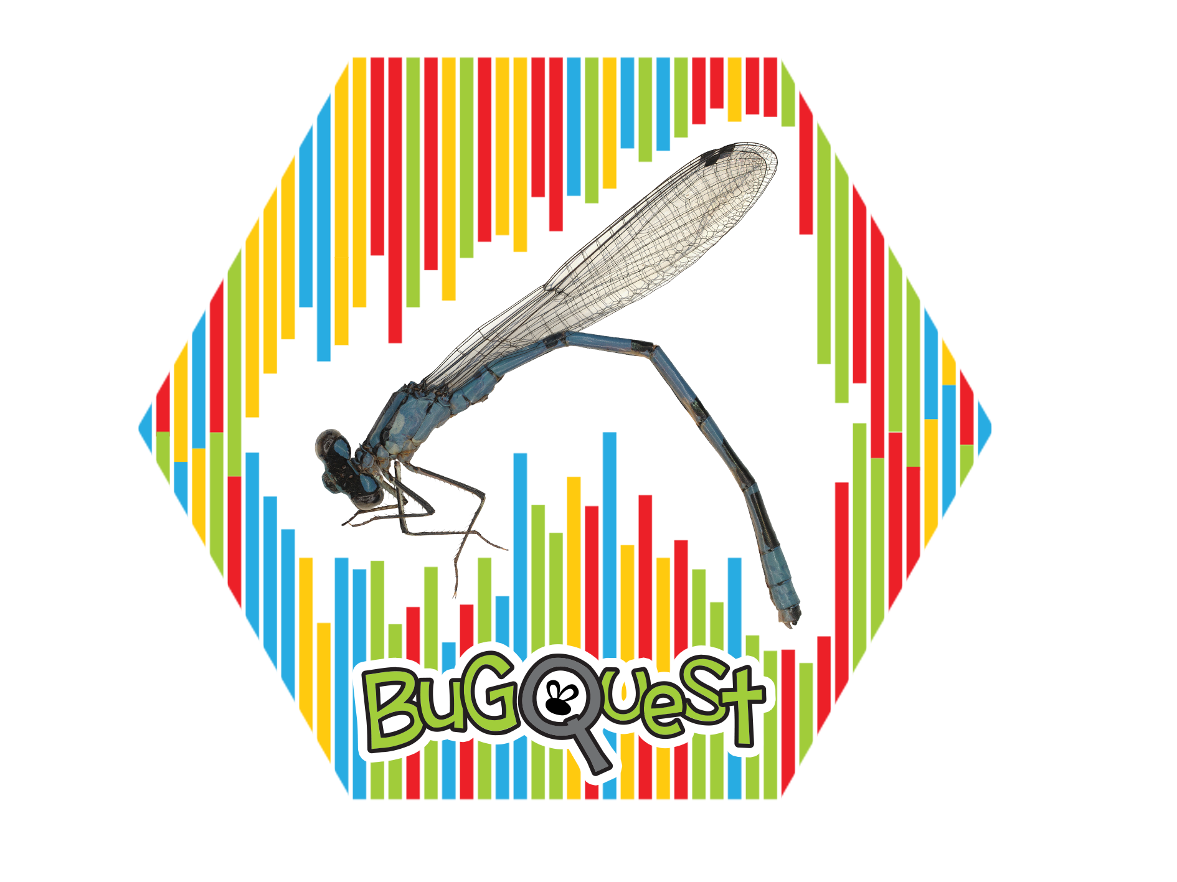

Slide 23
Enallagma
Damselflies

Slide 24


Slide 25
Graphocephala fennahi
Rhododendron leafhopper

Slide 26


Slide 27
Hemaris diffinis
Snowberry clearwing

Slide 28


Slide 29
Lignyodes helvolus
Seed weevil

Slide 30
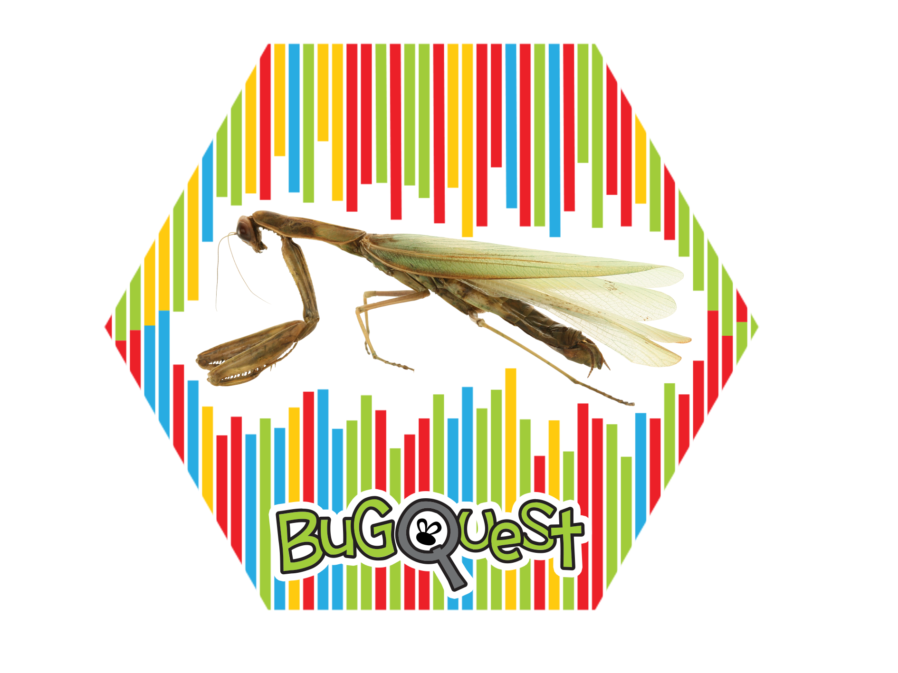

Slide 31
Mantis religiosa
European Mantis

Slide 32
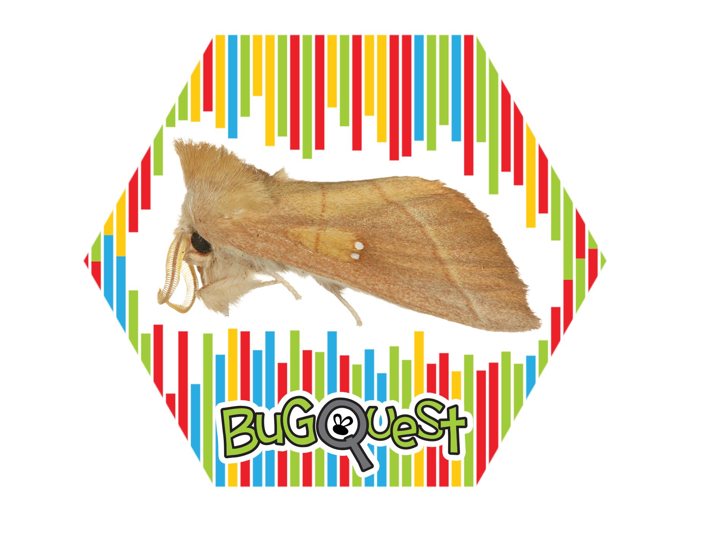

Slide 33
Nadata gibbosa
Rough prominent moth

Slide 34
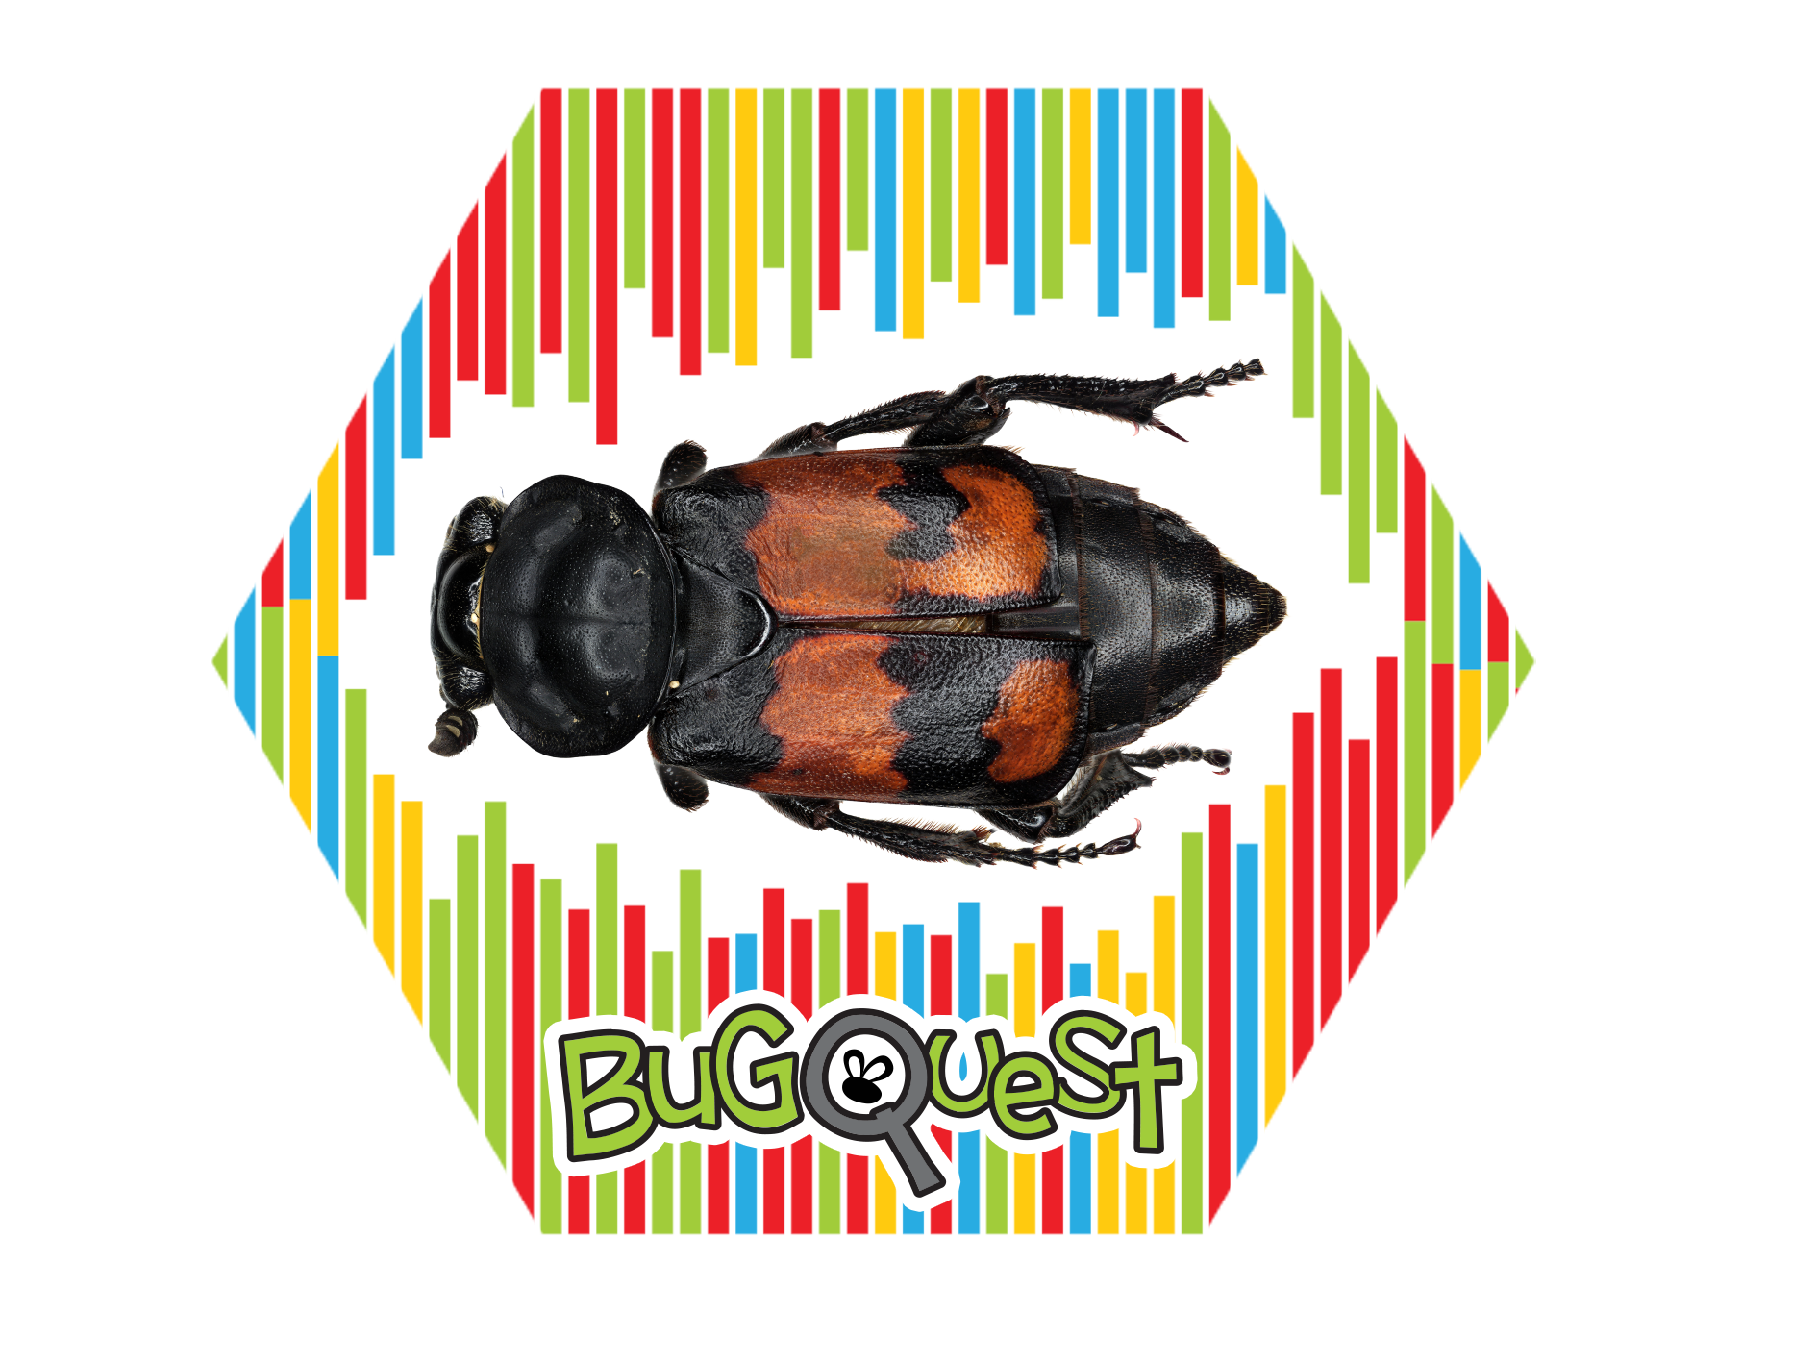

Slide 35
Nicrophorus vespilloides
Buring beetle

Slide 36
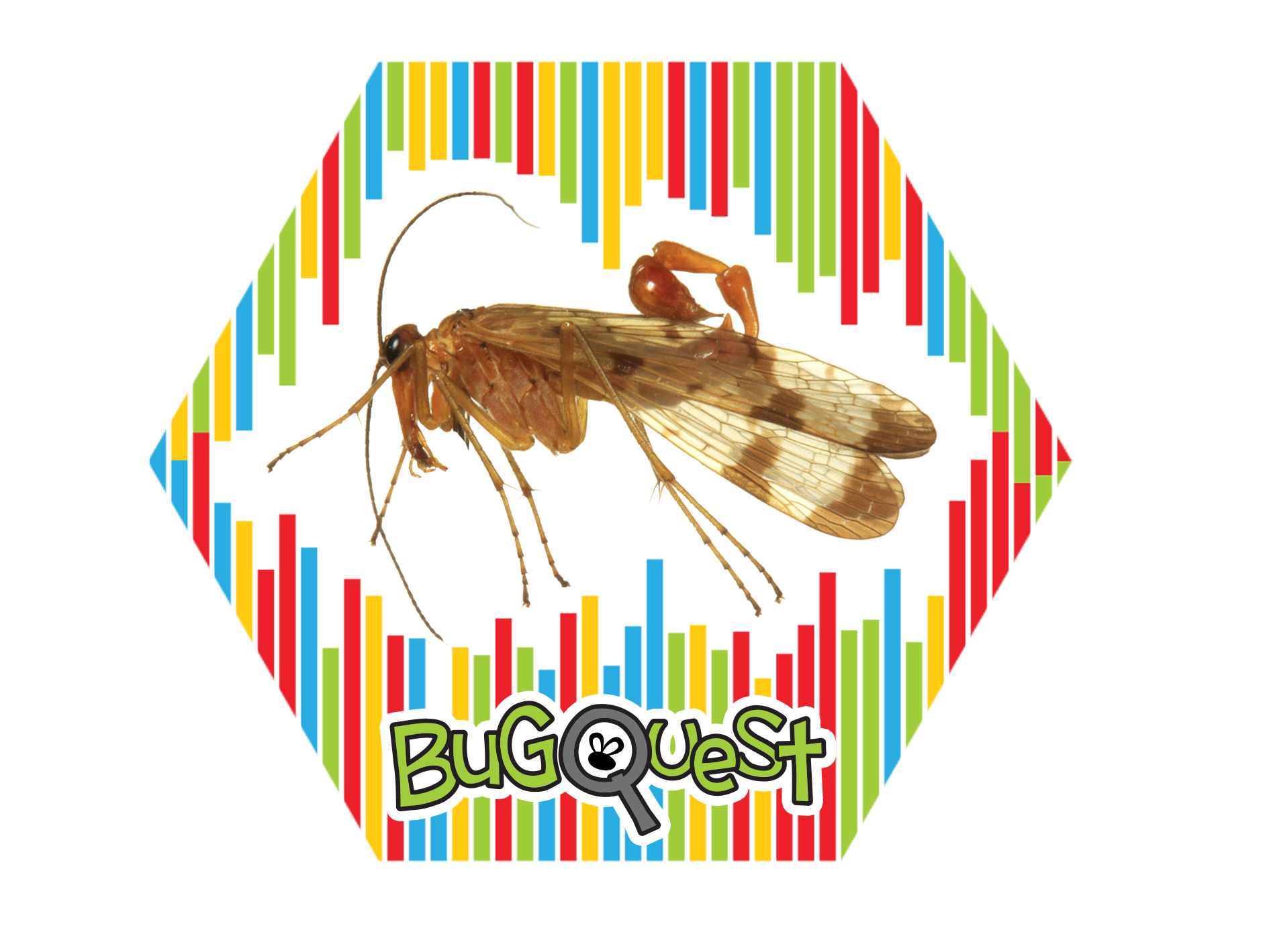

Slide 37
Panorpa debilis
Scorpionfly

Slide 38
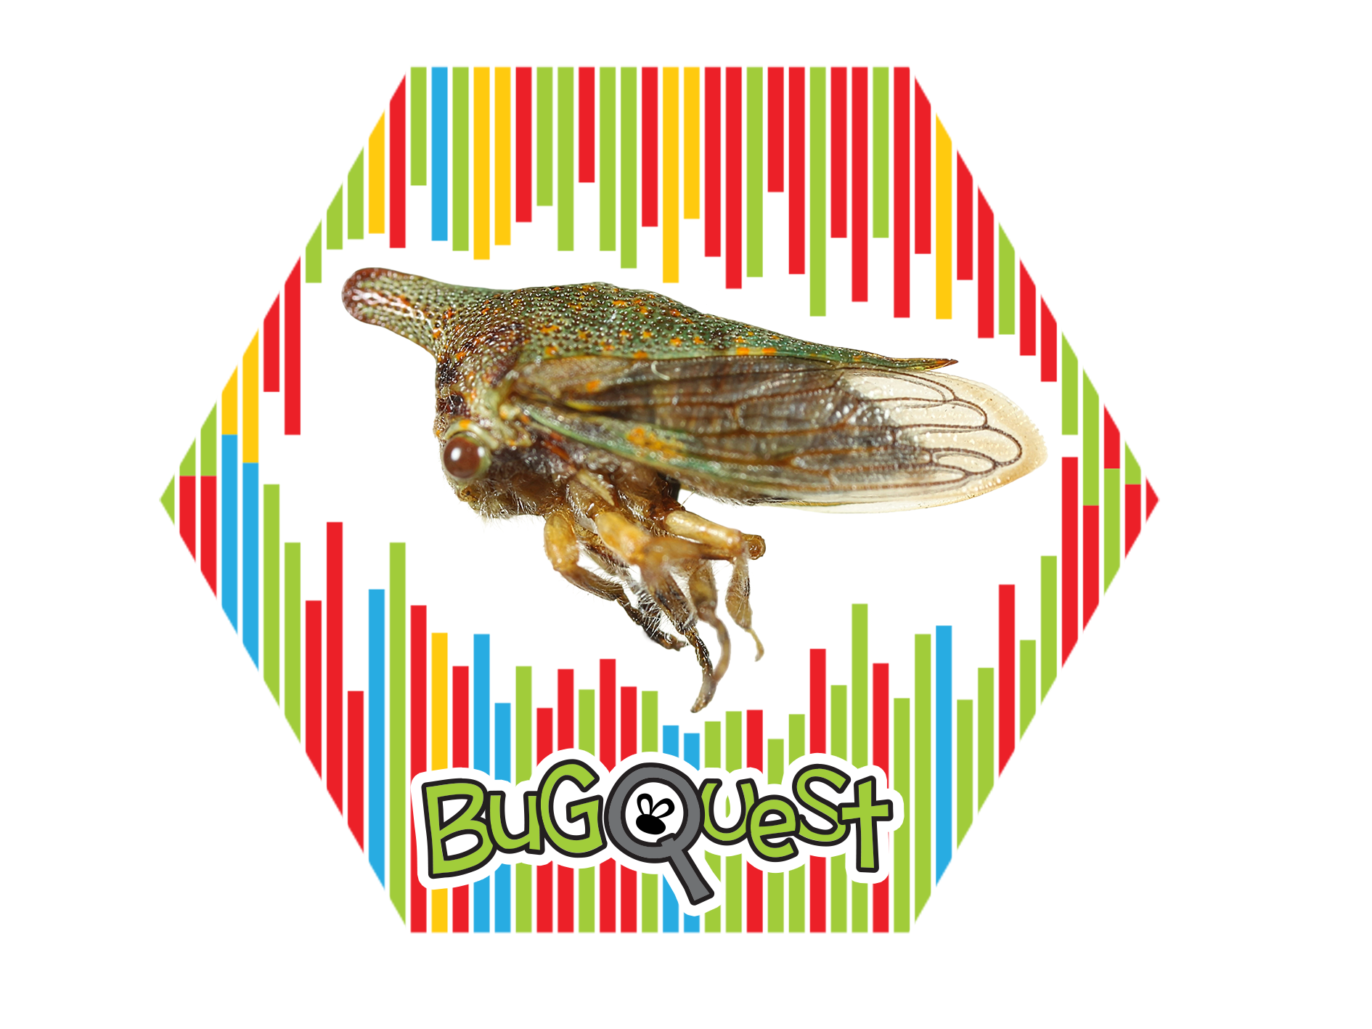

Slide 39
Platycotis vittata
Oak treehopper

Slide 40


Slide 41
Poecilanthrax sackenii
Large bee fly

Slide 42


Slide 43
Polydrusus Formosa
Green immigrant leaf weevil

Slide 44


Slide 45
Polygonia comma
Eastern comma

Slide 46


Slide 47
Stictocephala bisonia
Buffalo treehopper

Slide 48


Slide 49
Stratiomys barbata
Solider fly

